Slide 1
Kentucky All Schedule
Prescription Electronic Reporting
Quarterly Trend Report
3rd Quarter 2024 Cabinet for Health and Family Services
Office of Inspector General
275 E. Main Street
Frankfort, KY 40621

Slide 2
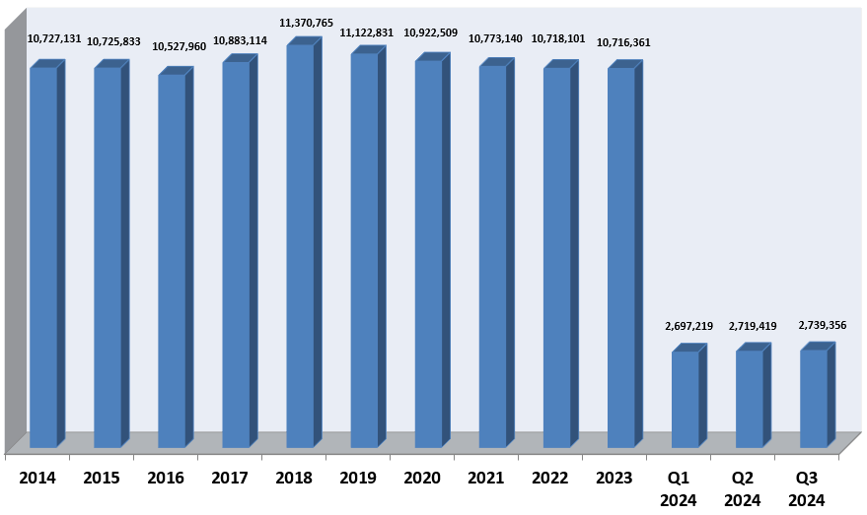
KASPER Records Added 2014 – Q3 2024

Slide 3
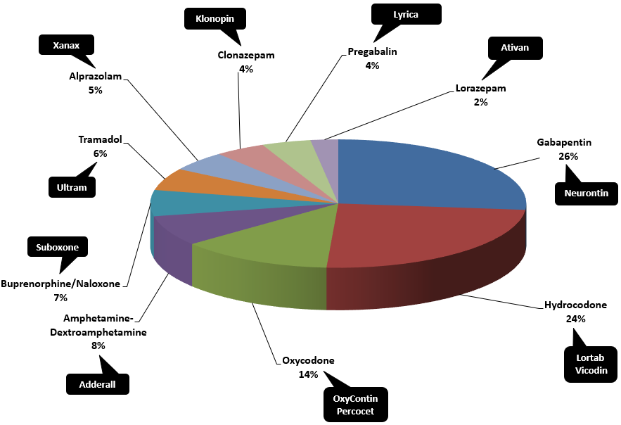
Top Prescribed Controlled Substances by Therapeutic Category by Doses – Q3 2024

Slide 4
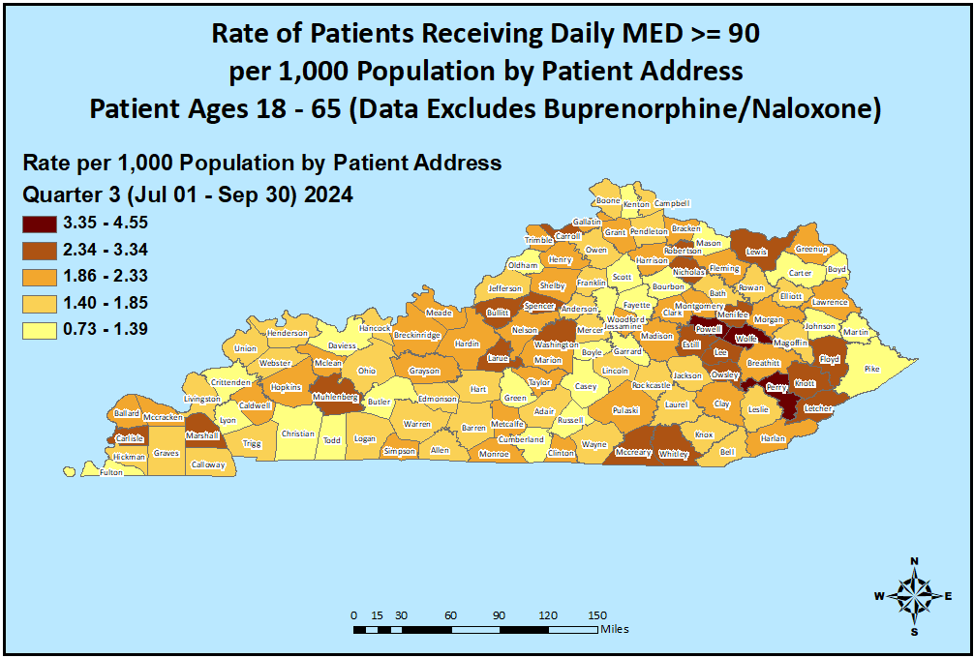
Opioid Morphine Equivalent Dose (MED) Data Q3 2024

Slide 5
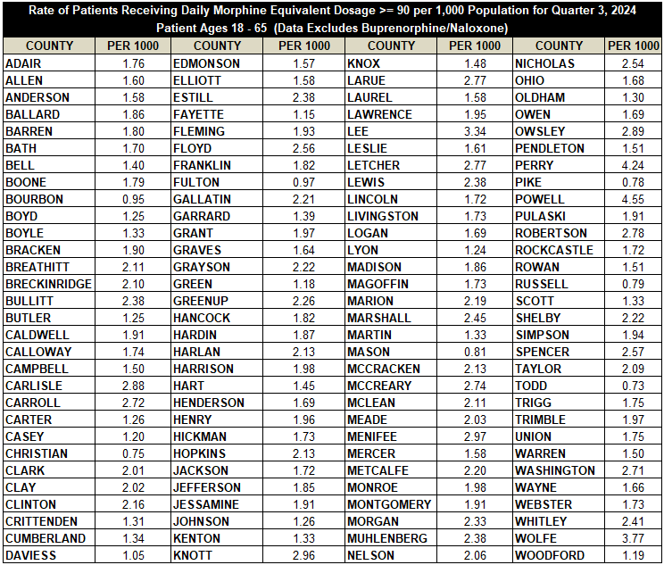
Opioid Morphine Equivalent Dose (MED) Data Q3 2024

Slide 6
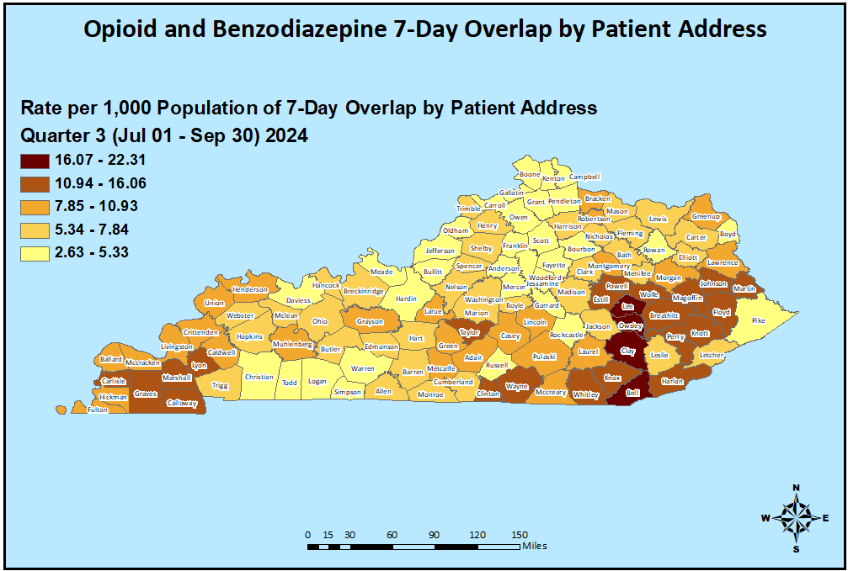
Patients with Seven or More Days of Overlapping Opioid
and Benzodiazepine Prescriptions Q3 2024

Slide 7
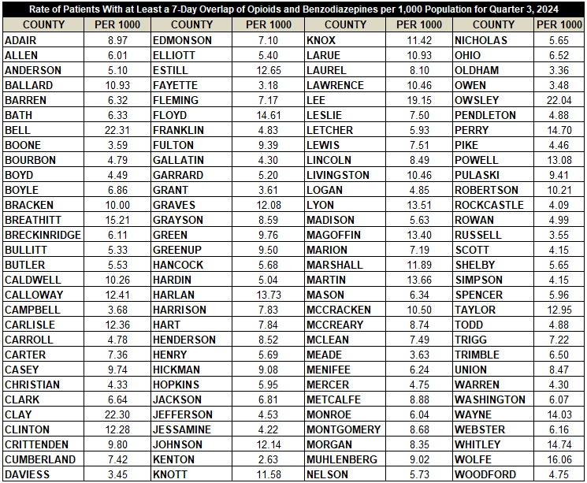
Patients with Seven or More Days of Overlapping Opioid
and Benzodiazepine Prescriptions Q3 2024

Slide 8
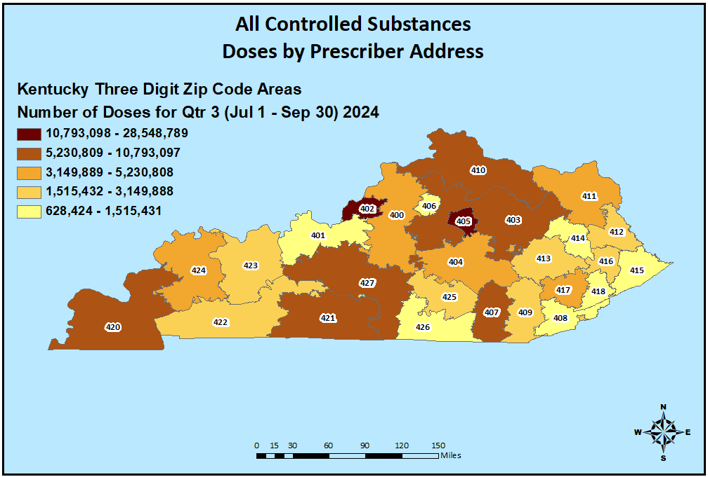
Controlled Substance Prescribing Q3 2024

Slide 9
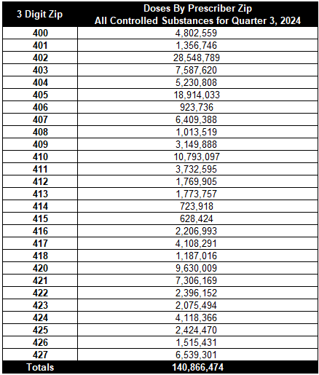
Controlled Substance Prescribing Q3 2024

Slide 10
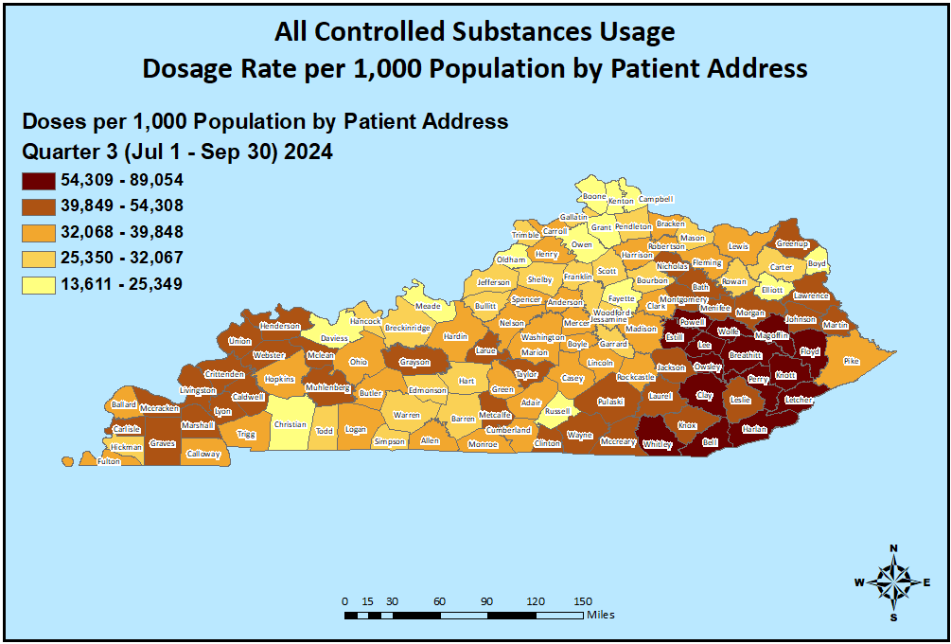
Controlled Substance Usage Q3 2024

Slide 11
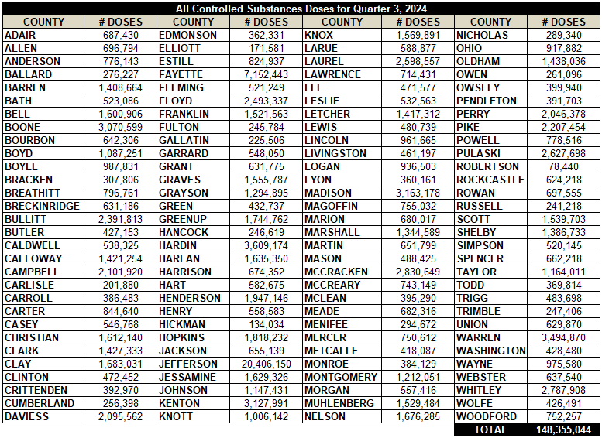
Controlled Substance Usage Q3 2024

Slide 12
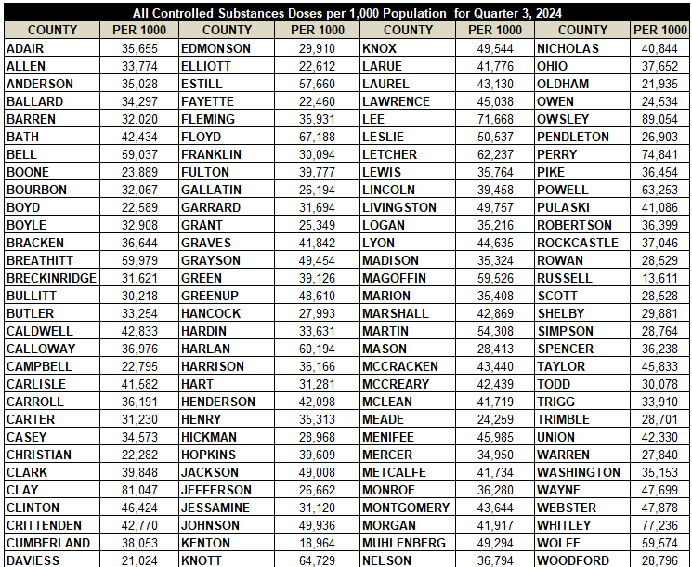
Controlled Substance Usage Per 1,000 Population Q3 2024

Slide 13
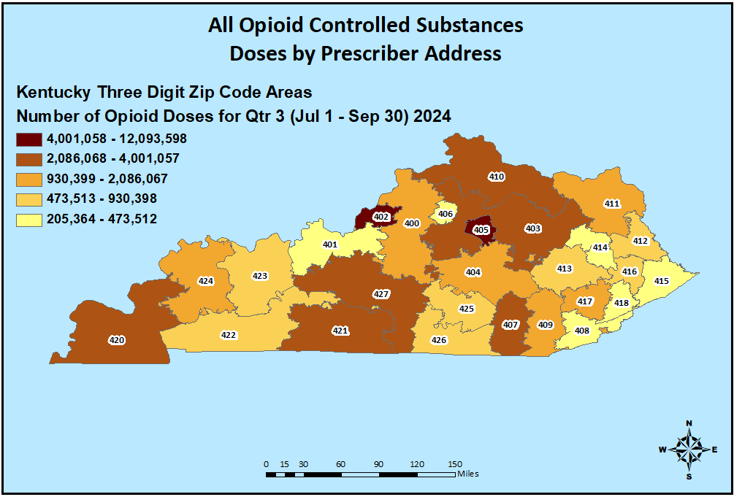
Opioid Prescribing Q3 2024

Slide 14
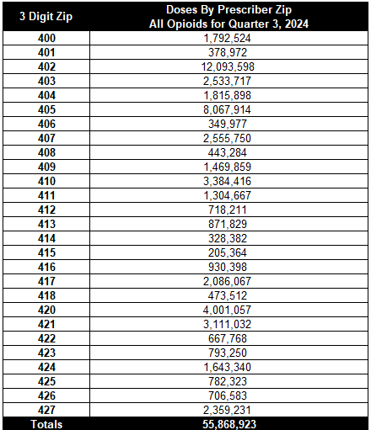
Opioid Prescribing Q3 2024

Slide 15
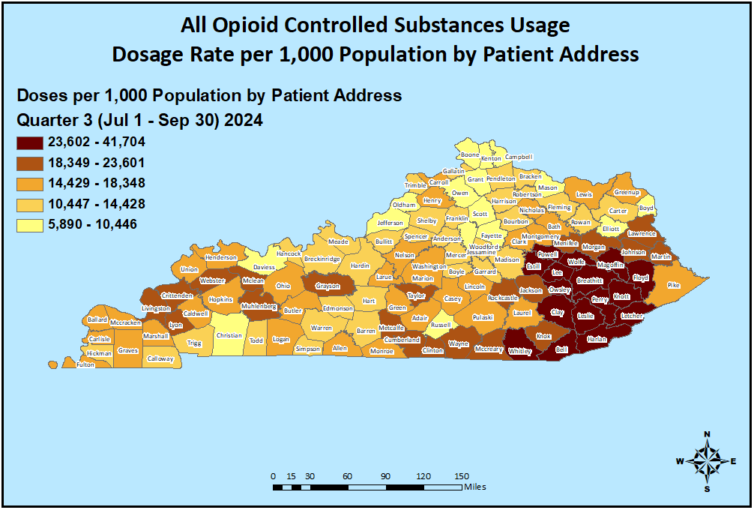
Opioid Usage Q3 2024

Slide 16
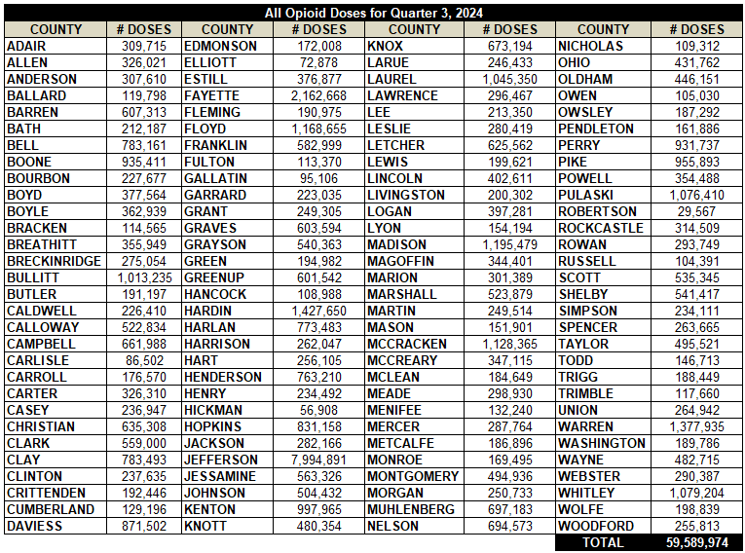
Opioid Usage Q3 2024

Slide 17
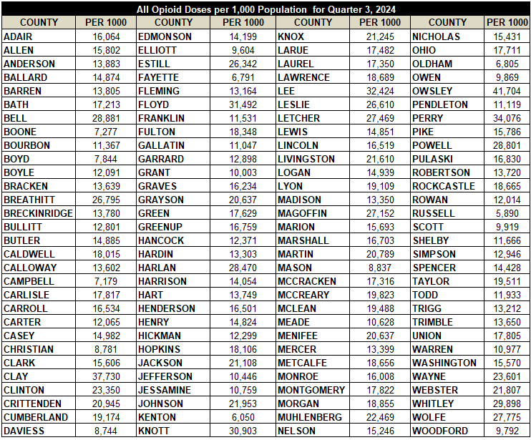
Opioid Usage Per 1,000 Population Q3 2024

Slide 18
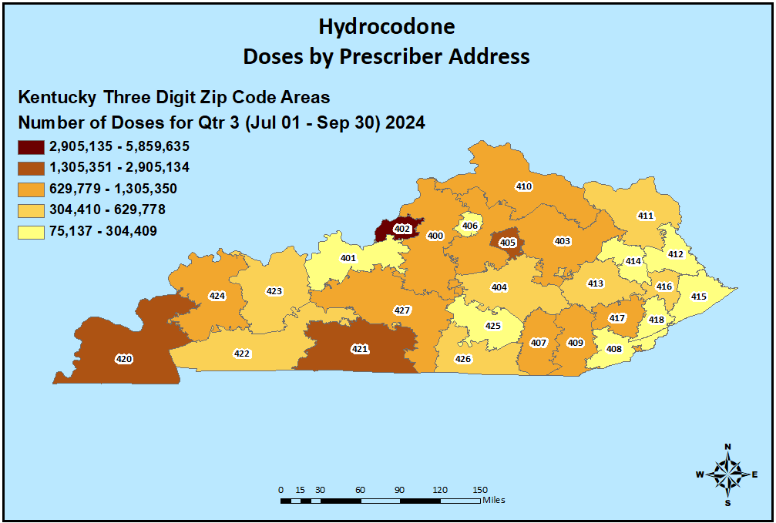
Hydrocodone Prescribing Q3 2024

Slide 19
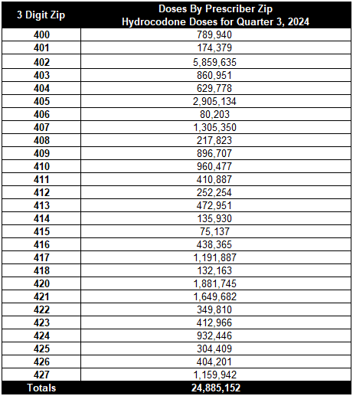
Hydrocodone Prescribing Q3 2024

Slide 20
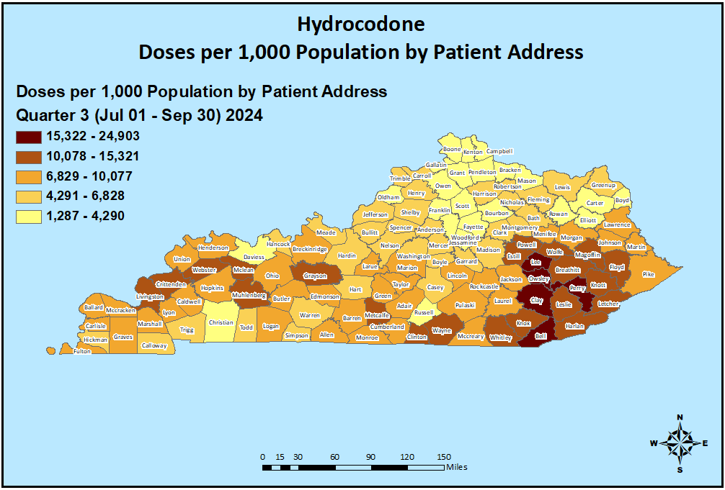
Hydrocodone Usage Q3 2024

Slide 21
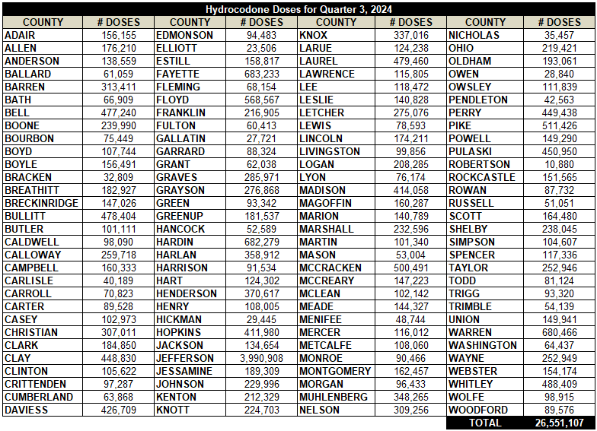
Hydrocodone Usage Q3 2024

Slide 22
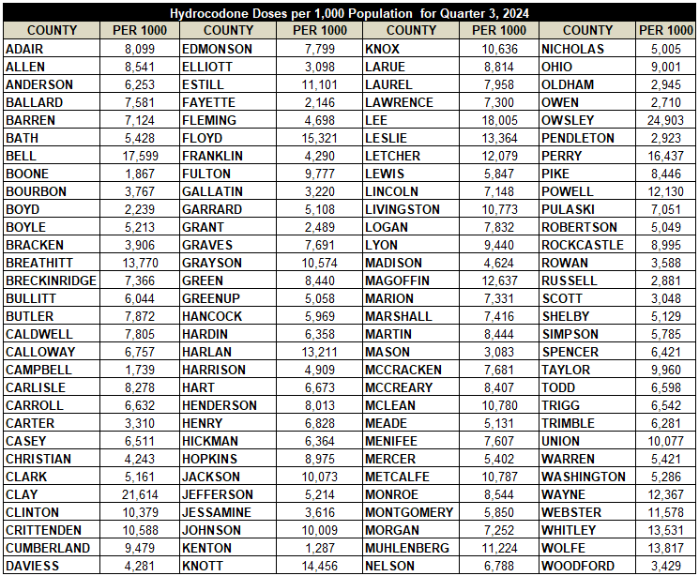
Hydrocodone Usage Per 1,000 Population Q3 2024

Slide 23
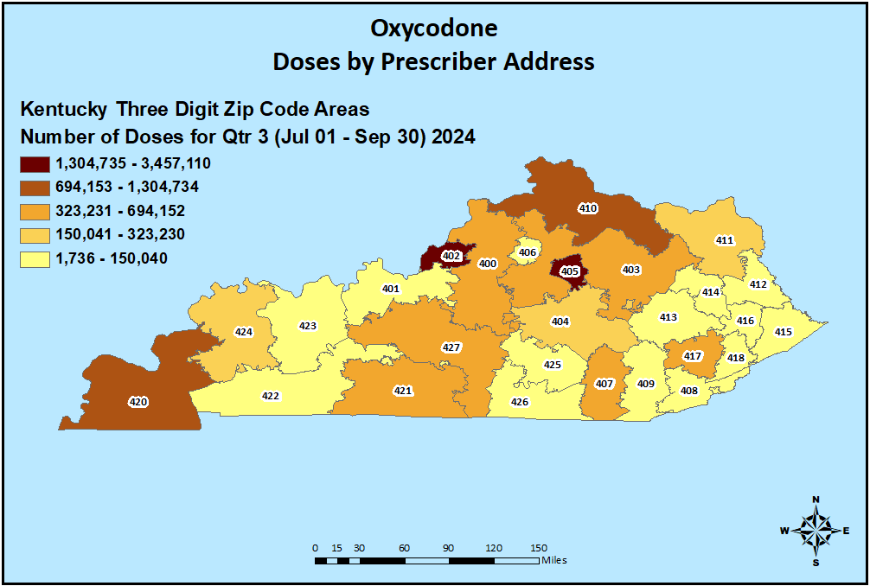
Oxycodone Prescribing Q3 2024

Slide 24
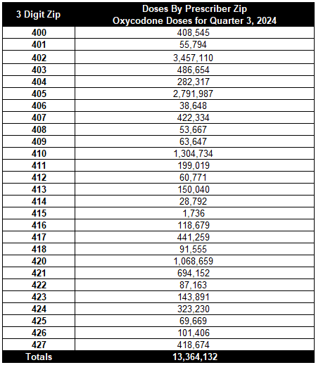
Oxycodone Prescribing Q3 2024

Slide 25
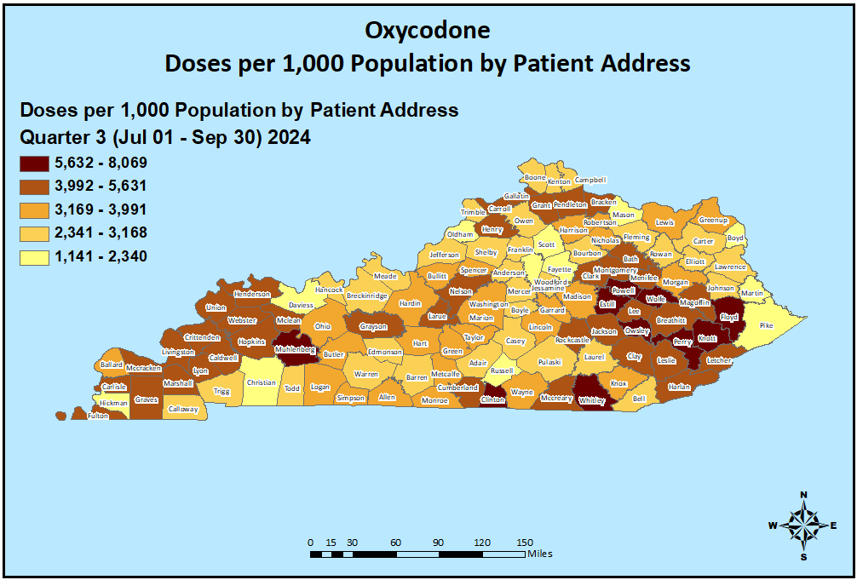
Oxycodone Usage Q3 2024

Slide 26
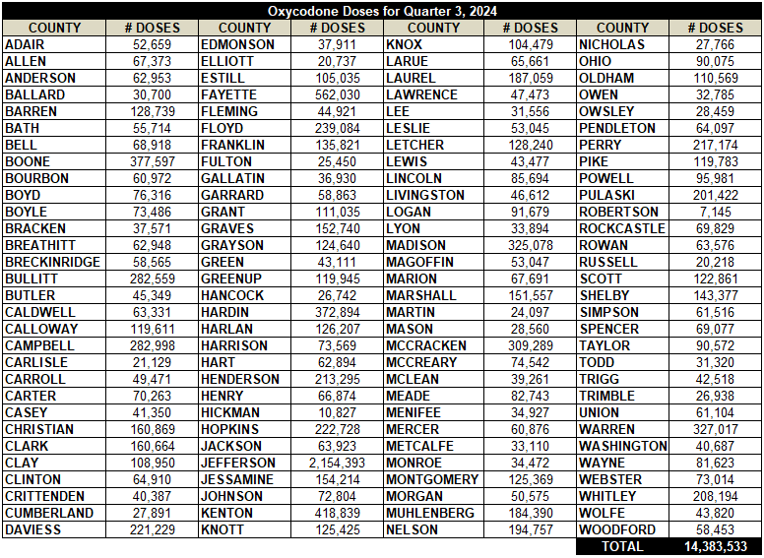
Oxycodone Usage Q3 2024

Slide 27
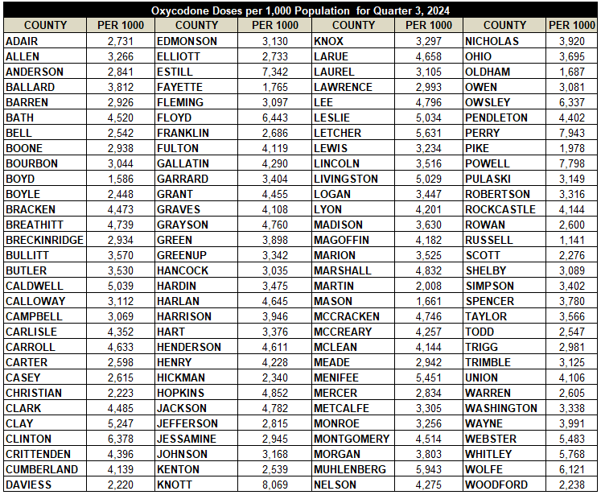
Oxycodone Usage Per 1,000 Population Q3 2024

Slide 28
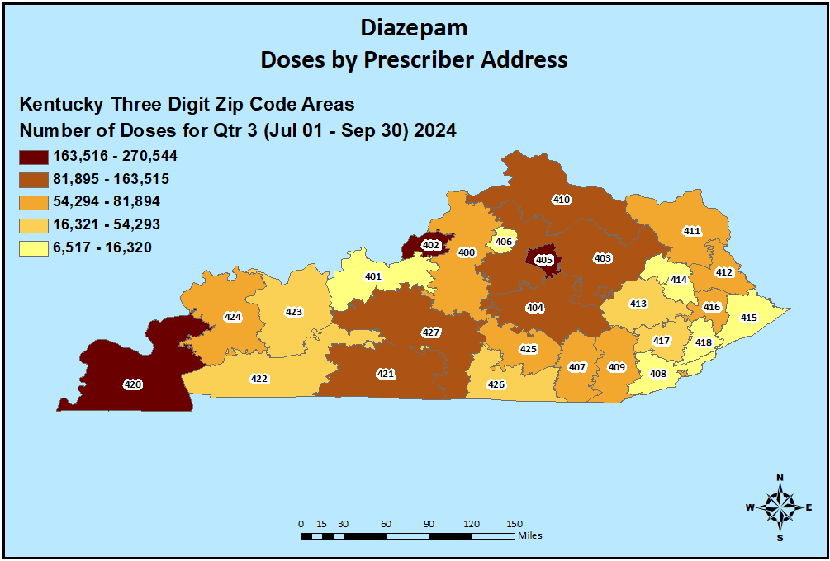
Diazepam Prescribing Q3 2024

Slide 29
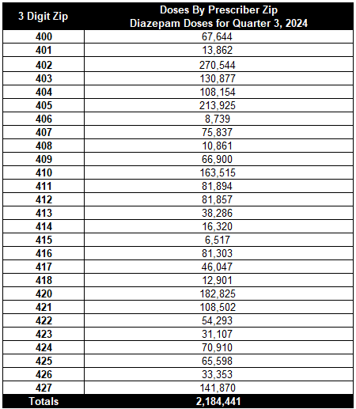
Diazepam Prescribing Q3 2024

Slide 30
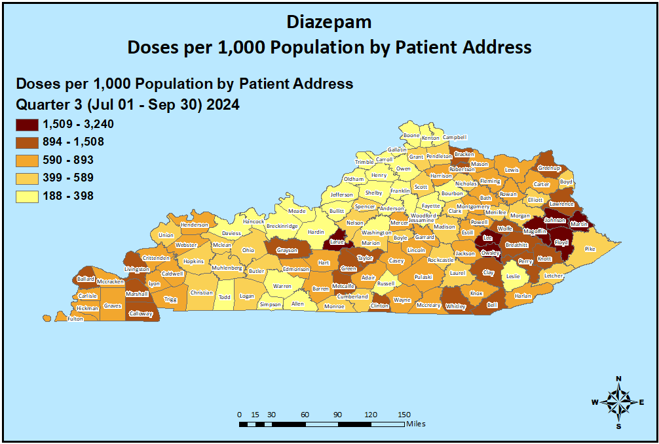
Diazepam Usage Q3 2024

Slide 31
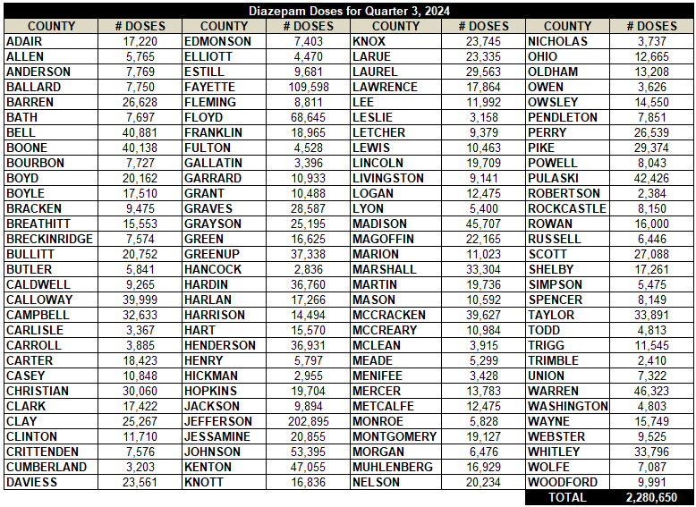
Diazepam Usage Q3 2024

Slide 32
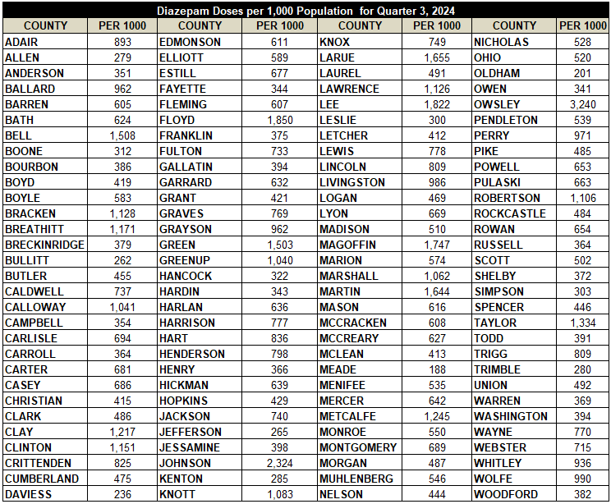
Diazepam Usage Per 1,000 Population Q3 2024

Slide 33
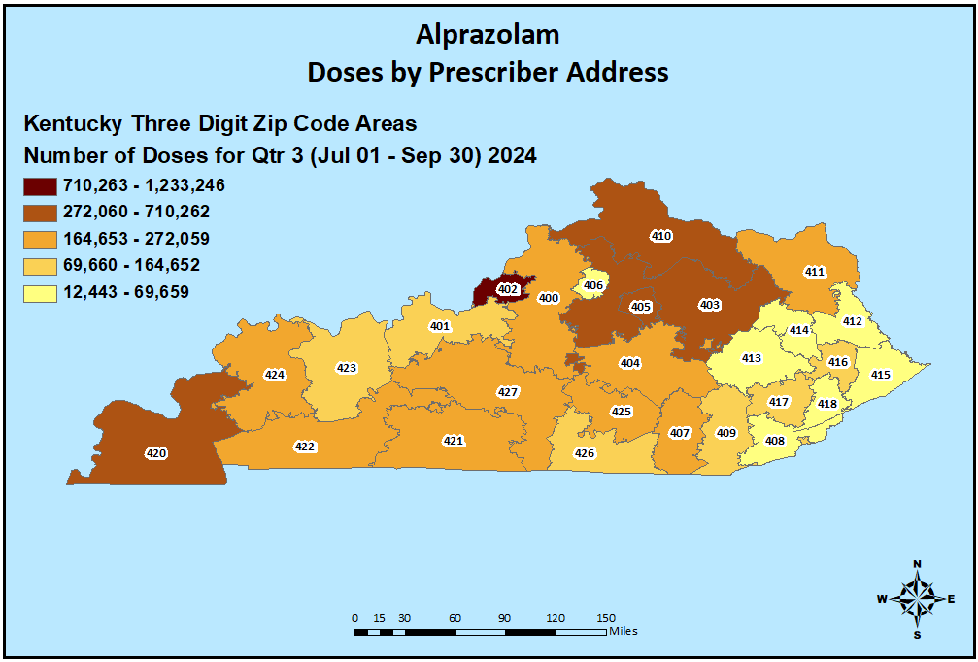
Alprazolam Prescribing Q3 2024

Slide 34
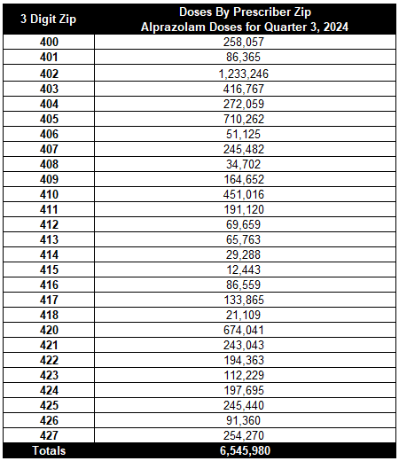
Alprazolam Prescribing Q3 2024

Slide 35
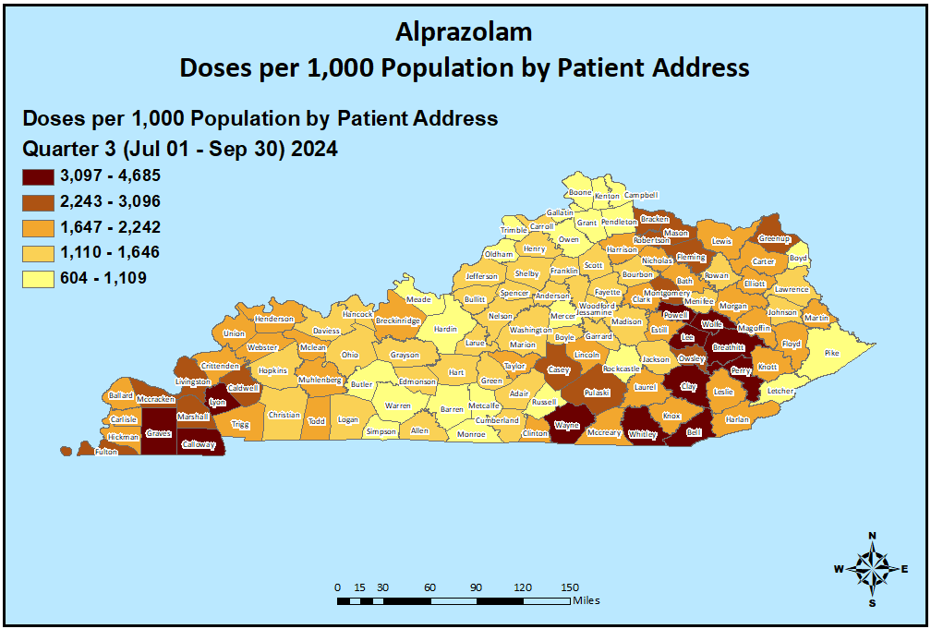
Alprazolam Usage Q3 2024

Slide 36
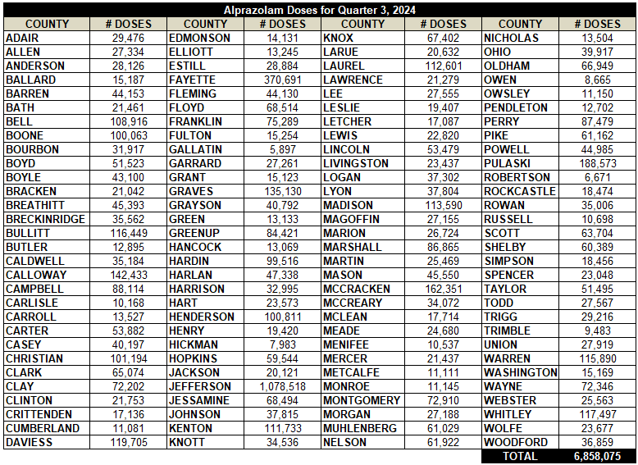
Alprazolam Usage Q3 2024

Slide 37
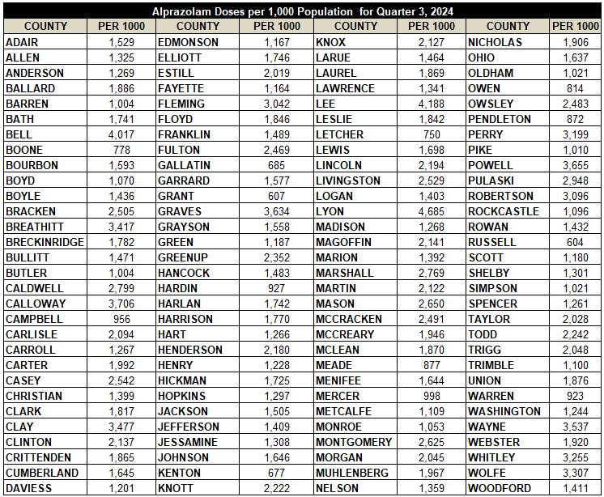
Alprazolam Usage Per 1,000 Population Q3 2024

Slide 38
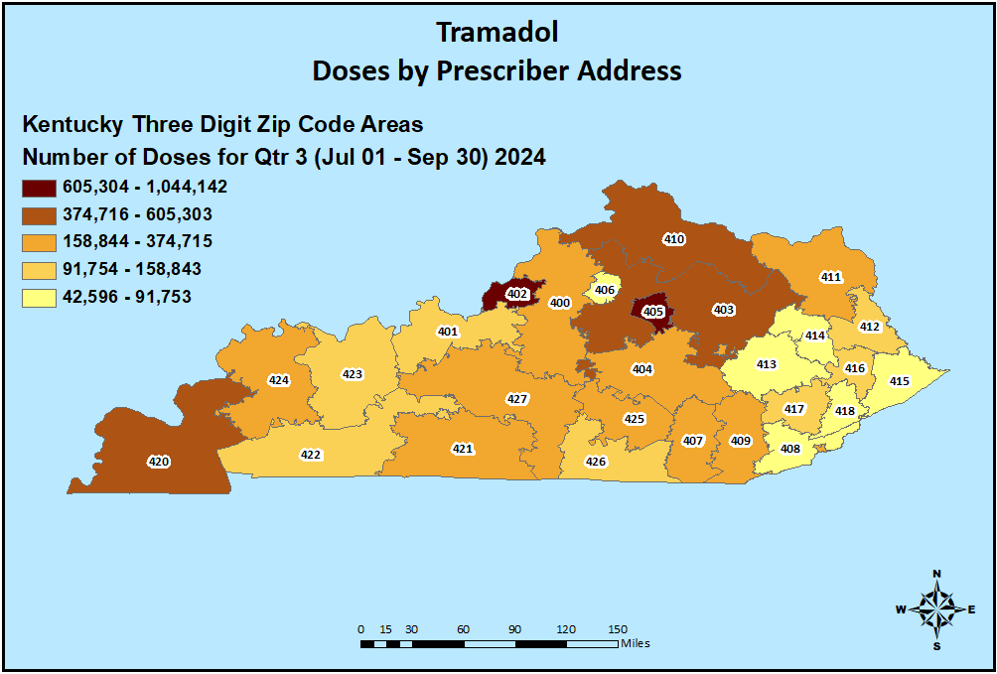
Tramadol Prescribing Q3 2024

Slide 39
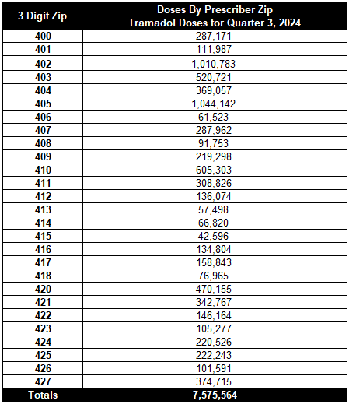
Tramadol Prescribing Q3 2024

Slide 40
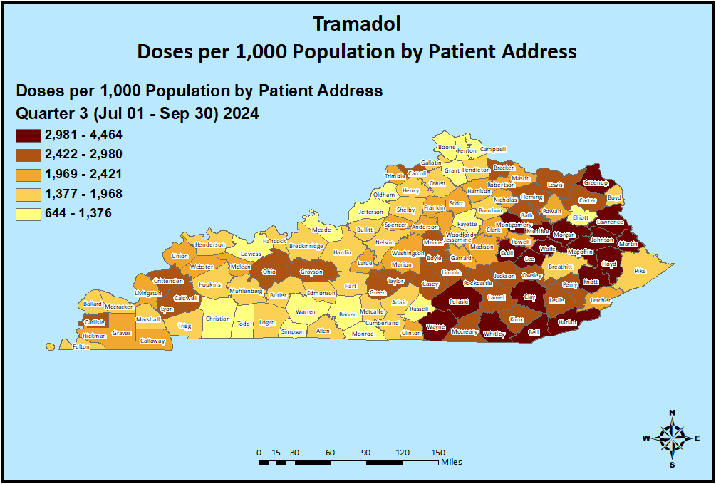
Tramadol Usage Q3 2024

Slide 41
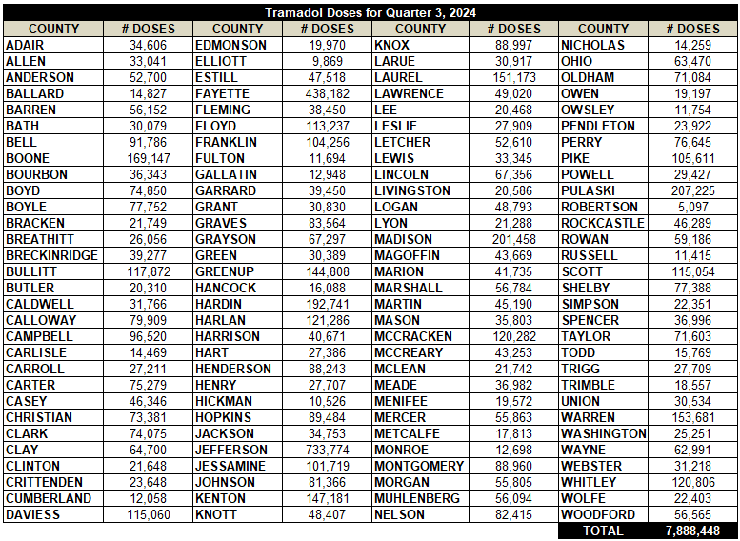
Tramadol Usage Q3 2024

Slide 42
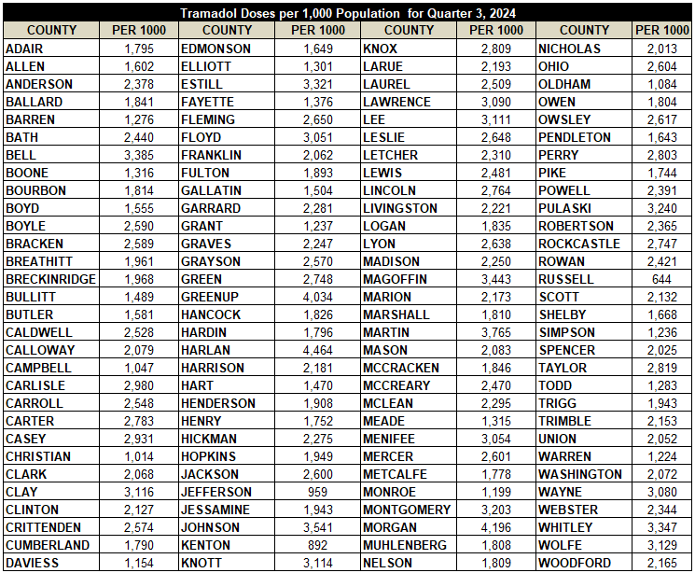
Tramadol Usage Per 1,000 Population Q3 2024

Slide 43
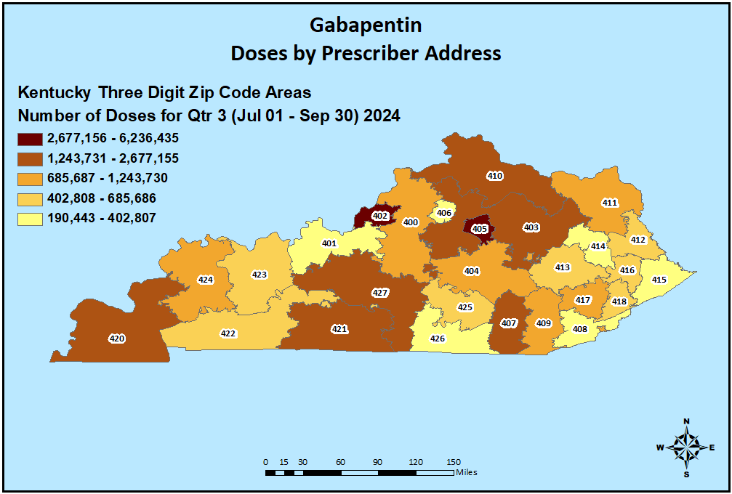
Gabapentin Prescribing Q3 2024

Slide 44
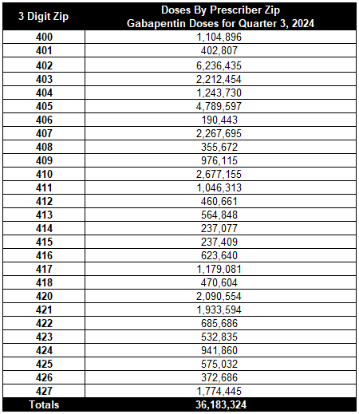
Gabapentin Prescribing Q3 2024

Slide 45
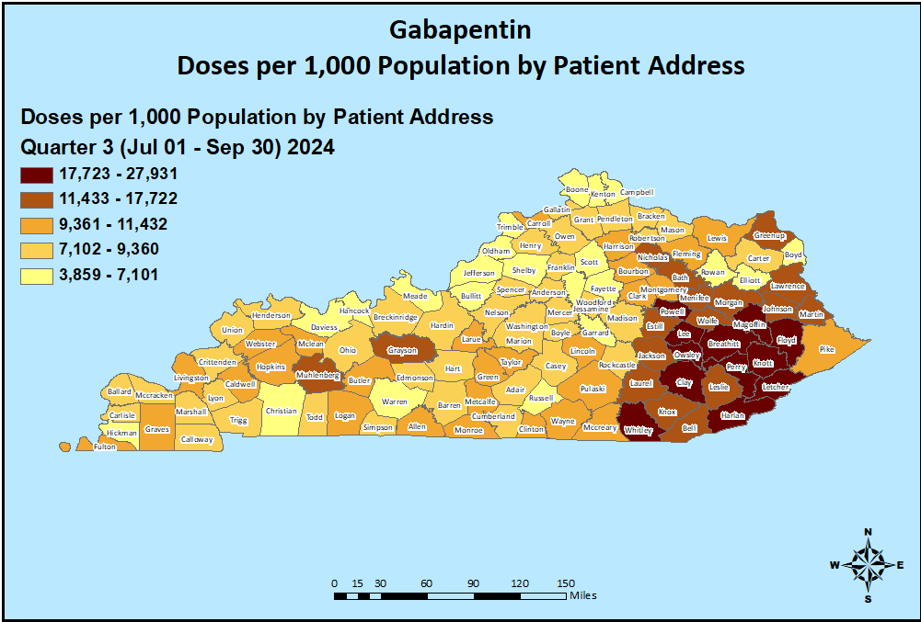
Gabapentin Usage Q3 2024

Slide 46
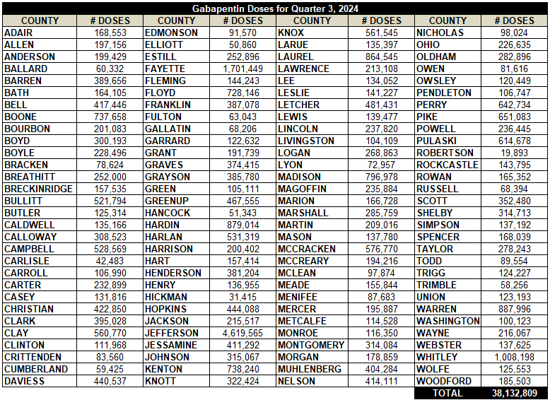
Gabapentin Usage Q3 2024

Slide 47
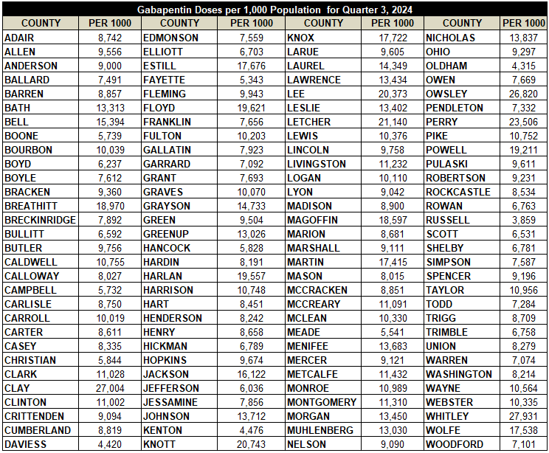
Gabapentin Usage Per 1,000 Population Q3 2024

Slide 48
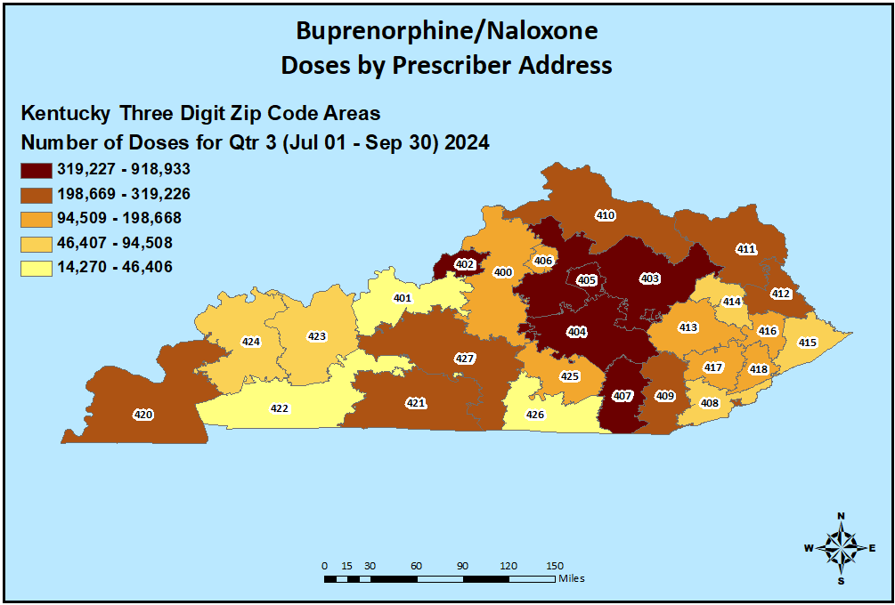
Buprenorphine/Naloxone Prescribing Q3 2024

Slide 49
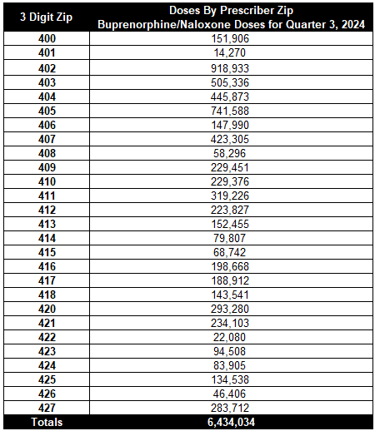
Buprenorphine/Naloxone Prescribing Q3 2024

Slide 50
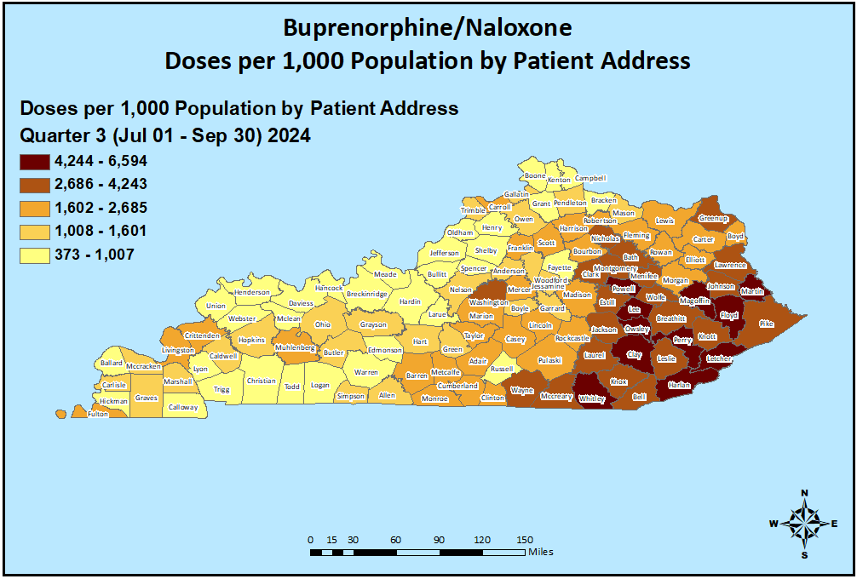
Buprenorphine/Naloxone Usage Q3 2024

Slide 51
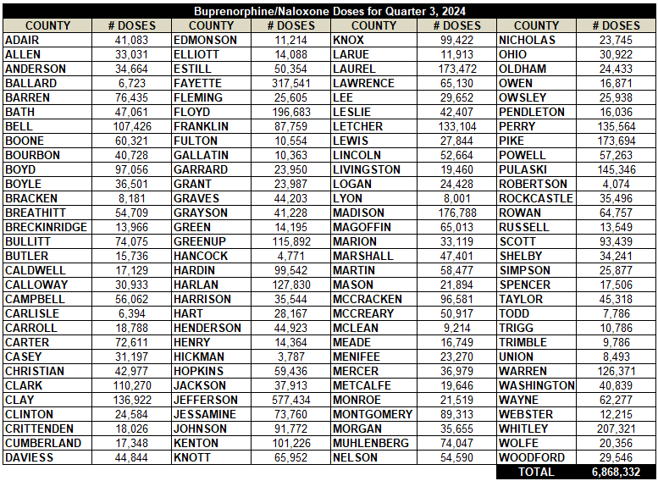
Buprenorphine/Naloxone Usage Q3 2024

Slide 52
Buprenorphine/Naloxone Usage Per 1,000 Population Q3 2024

Slide 53
Oxymorphone Prescribing Q3 2024

Slide 54
Oxymorphone Prescribing Q3 2024

Slide 55
Oxymorphone Usage Q3 2024

Slide 56
Oxymorphone Usage Q3 2024

Slide 57
Oxymorphone Usage Per 1,000 Population Q3 2024

